Slide 1


Slide 2
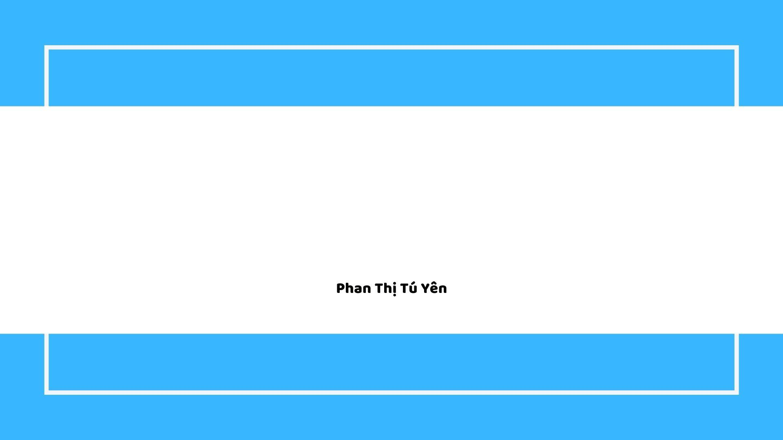
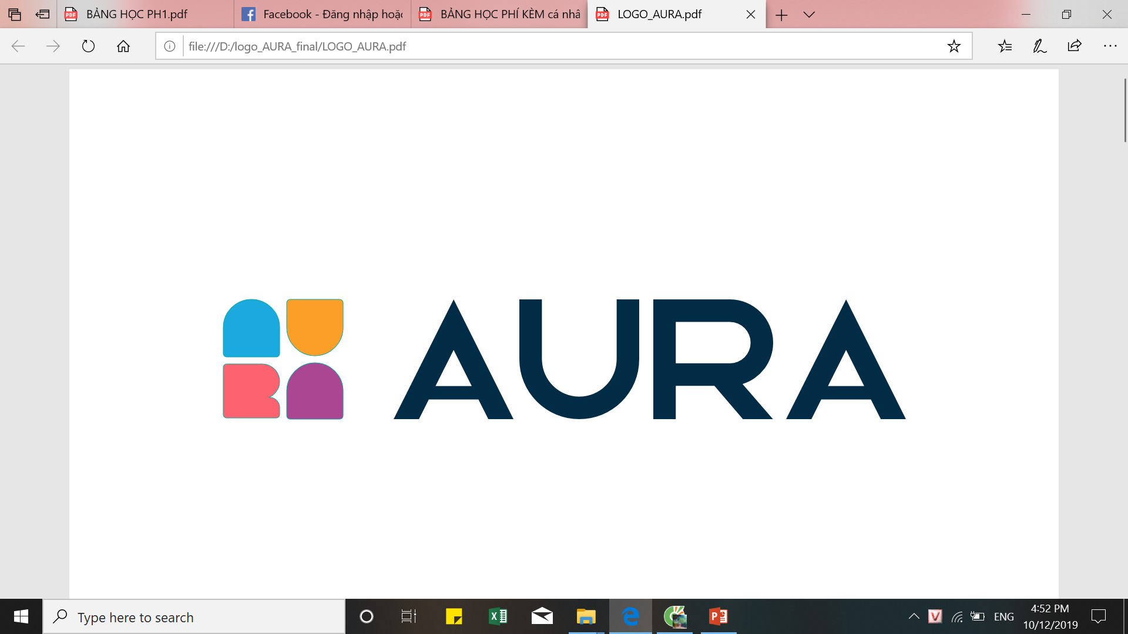
Unit 19: Shopping
Creator: Ms. Lizzie

Slide 3

Content
01.
Listening & Speaking
Shopping
02.
Grammar
Infinitive/ The “-ing form”/ Too-enough
03.
Pronunciation
/m/, /n/ & / ŋ/

Slide 4
01. Listening & Speaking

Slide 5

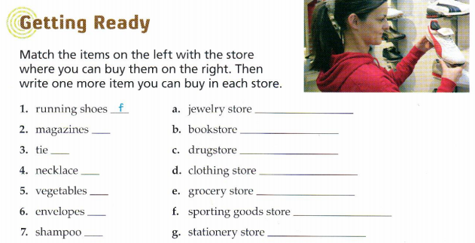

Slide 6
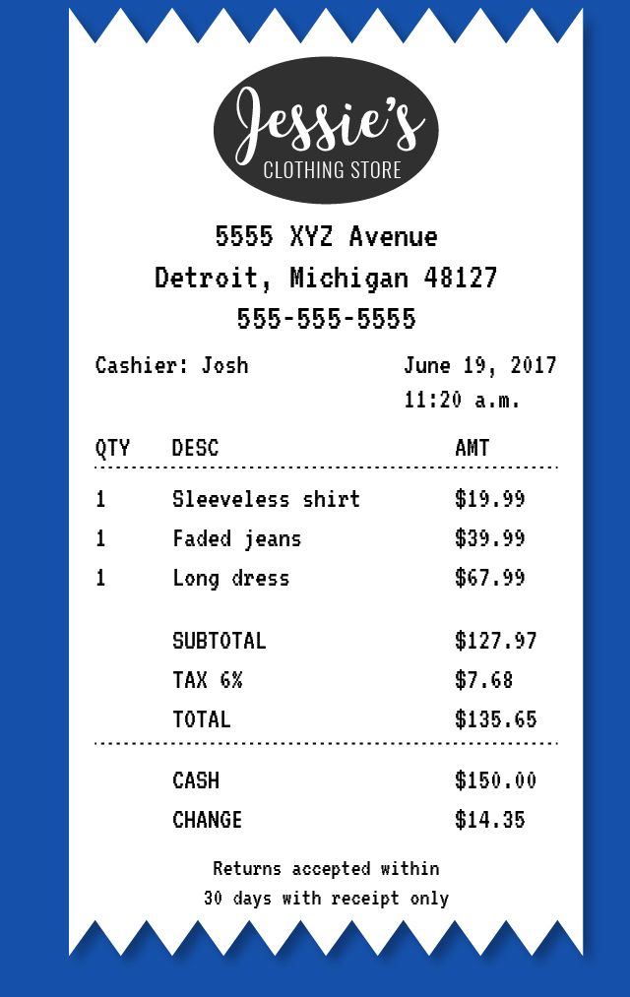
Vocabulary about shopping:
Receipt /rɪˈsiːt/
Make sure you are given a receipt for everything you buy.

Slide 7
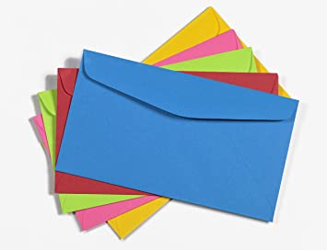

Vocabulary about shopping:
envelope
/ˈɑːn.və.loʊp/
E.g: Don’t forget to put a stamp on the envelope.

Slide 8
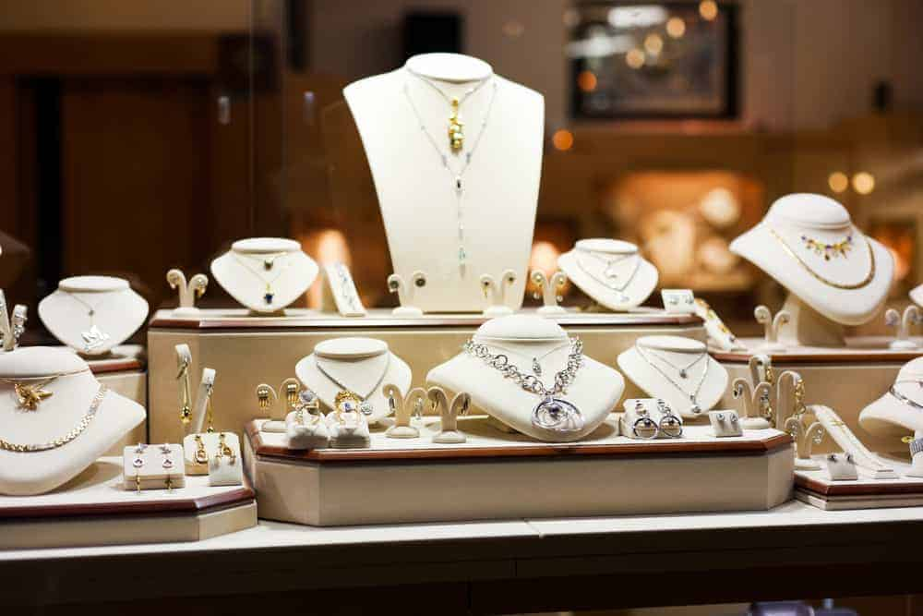
Vocabulary about shopping:
jewelry store
/ˈdʒuː.əl.ri stɔːr/
E.g: There is a very large jewelry store near my house.

Slide 9
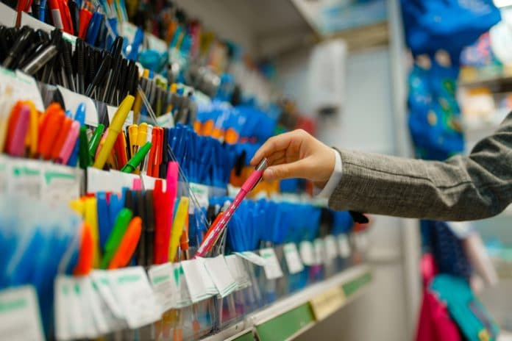
Vocabulary about shopping:
stationery store
/ˈsteɪ.ʃə.ner.i stɔːr/
E.g: I got these folders at the stationery store.

Slide 10
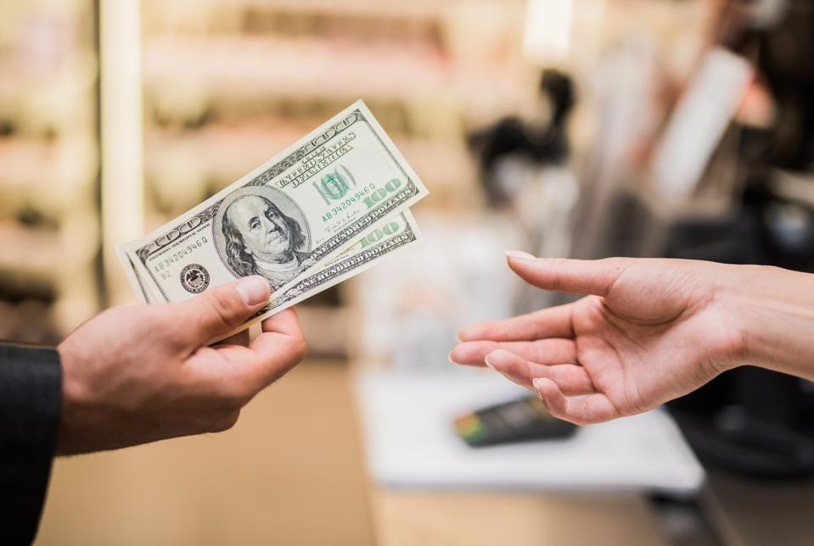
Vocabulary about shopping:
Cash/credit card/ check

Slide 11
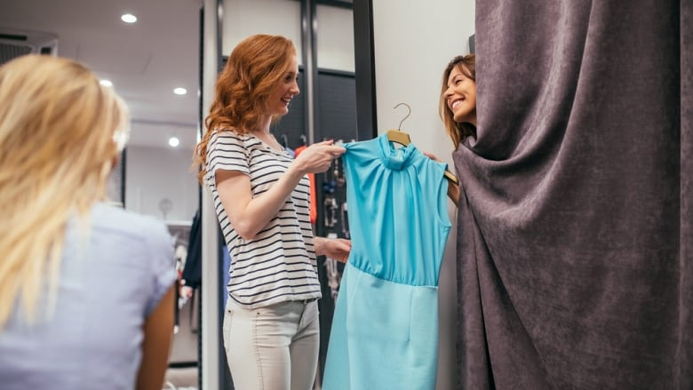
Vocabulary about shopping:
Try things on
Can I try on your coat?

Slide 12

Vocabulary about shopping:
Fitting room /ˈfɪt̬.ɪŋ ˌruːm/
The girl goes into the fitting room and try dress on.

Slide 13
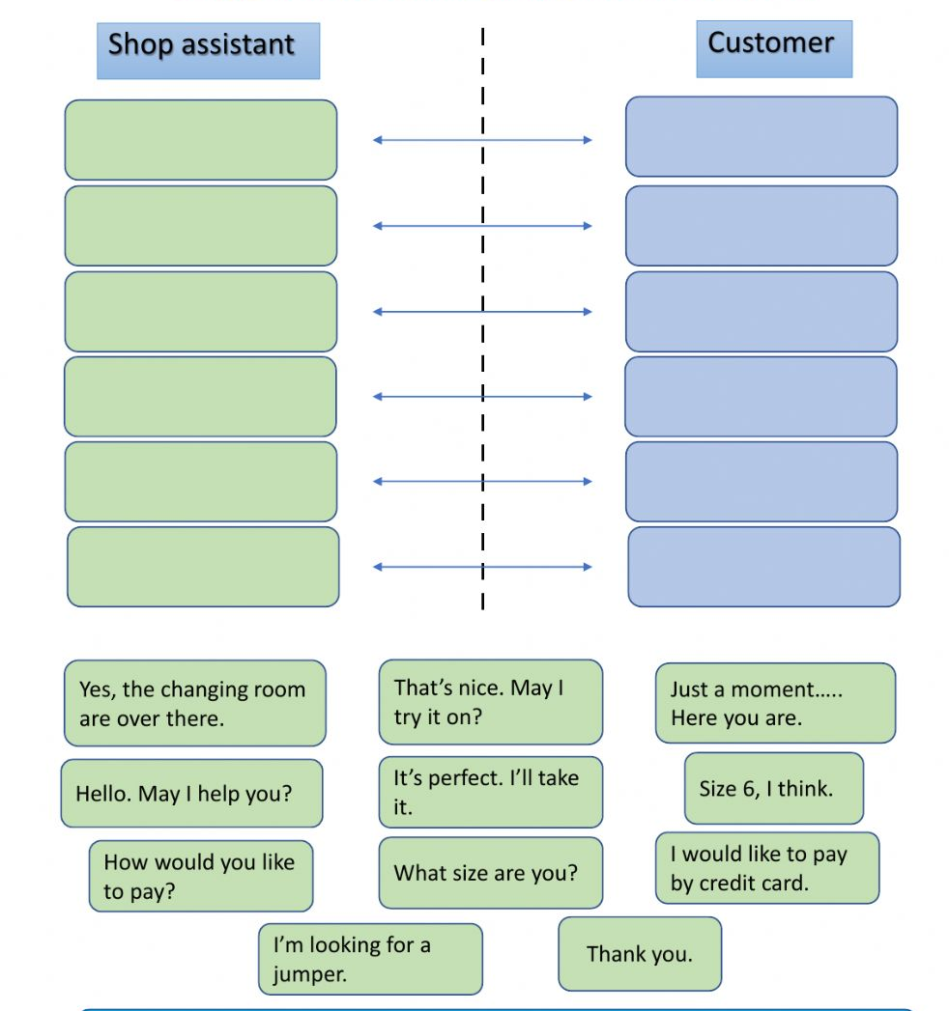
Shopping Role-play:
Notes:
Video about shopping

Slide 14
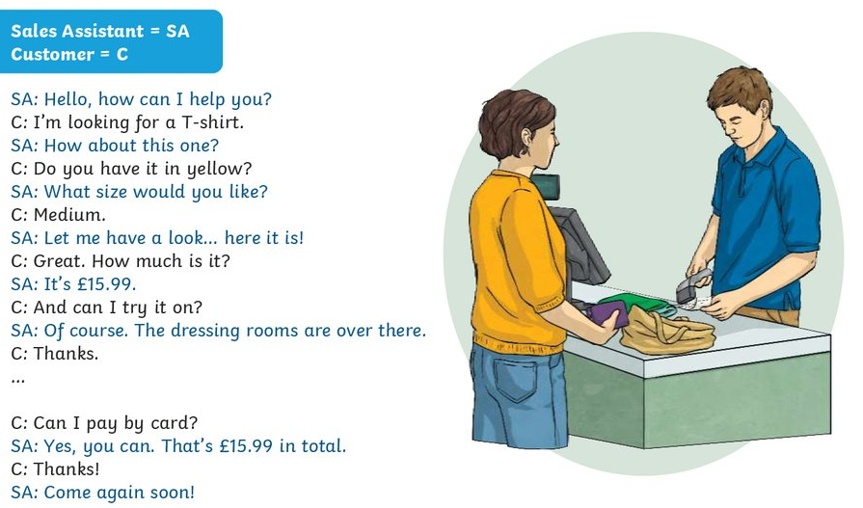
Notes:
Video about shopping

Slide 15
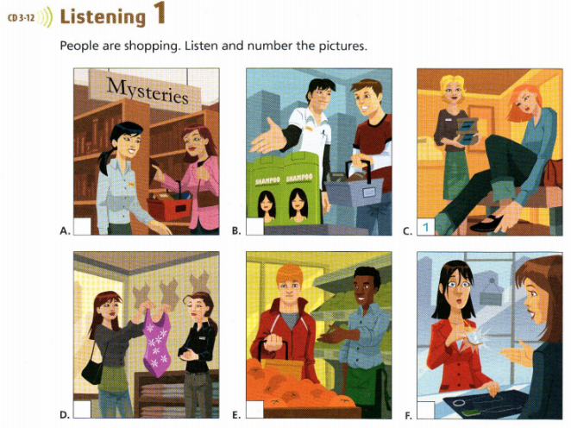
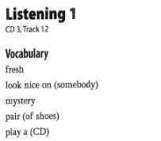
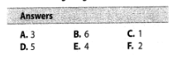

Slide 16

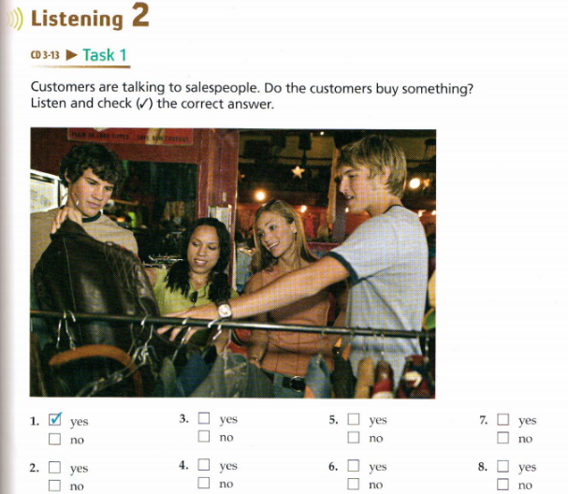
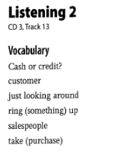
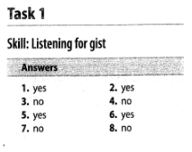

Slide 17
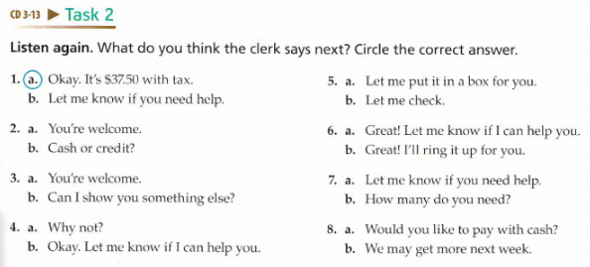
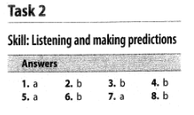

Slide 18
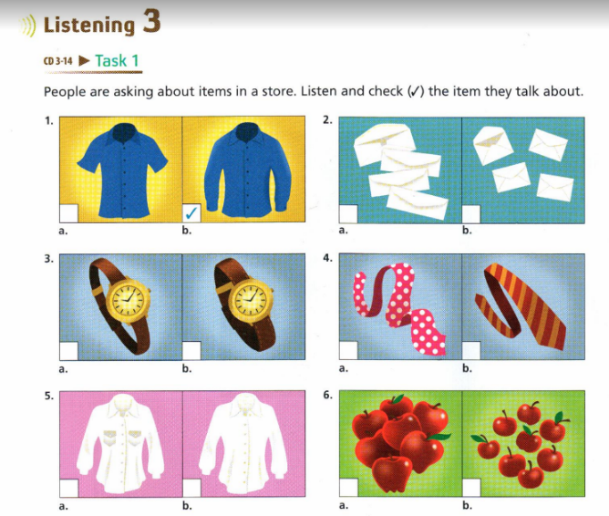
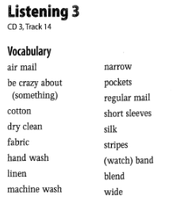
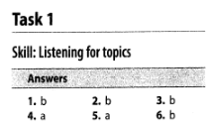

Slide 19
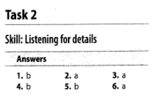
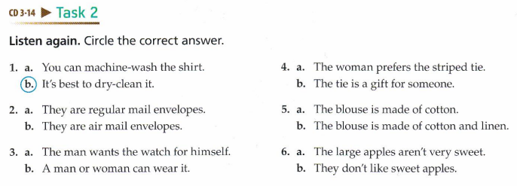

Slide 20
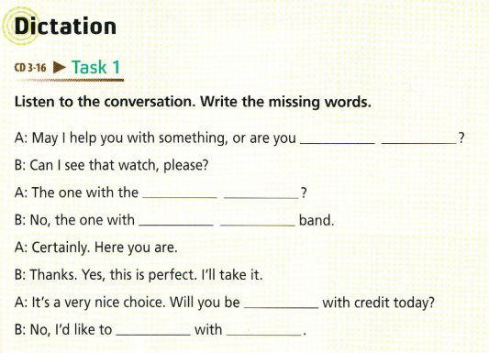
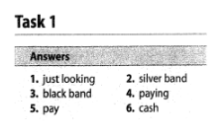

Slide 21
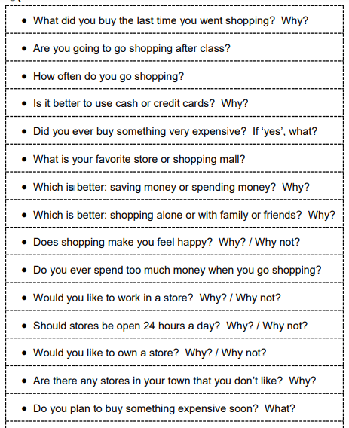
Speaking: Free Talk

Slide 22
02. Grammar

Slide 23
WARM-UP

Slide 24
REVIEW

Slide 25
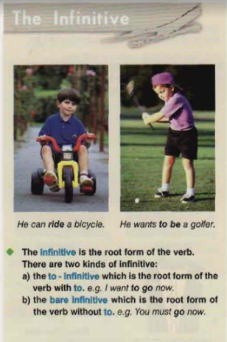
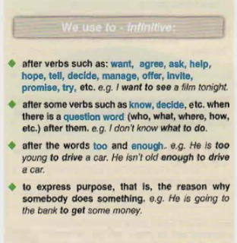
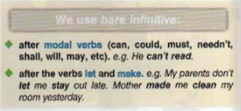
Notes:
eva

Slide 26
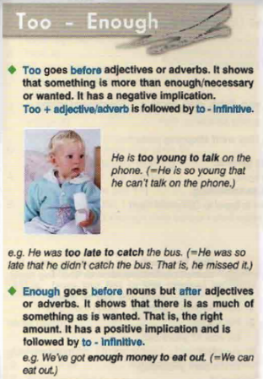
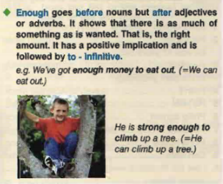
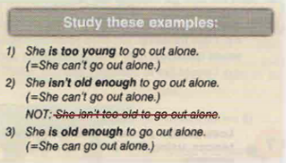

Slide 27
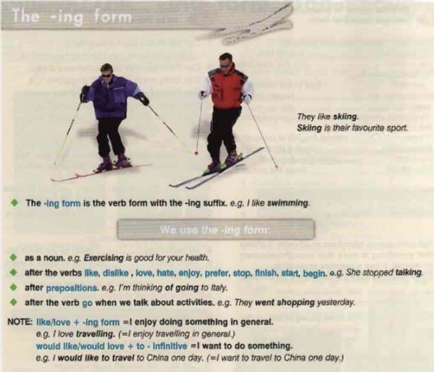

Slide 28
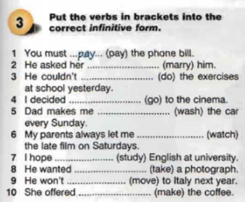

Slide 29
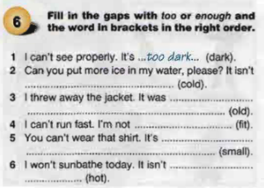

Slide 30
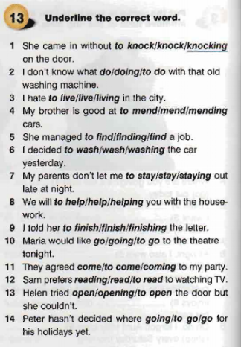
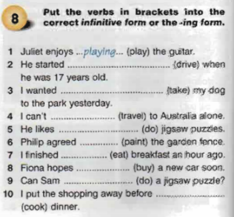

Slide 31
03. Pronunciation:
/n/ and /ŋ/

Slide 32
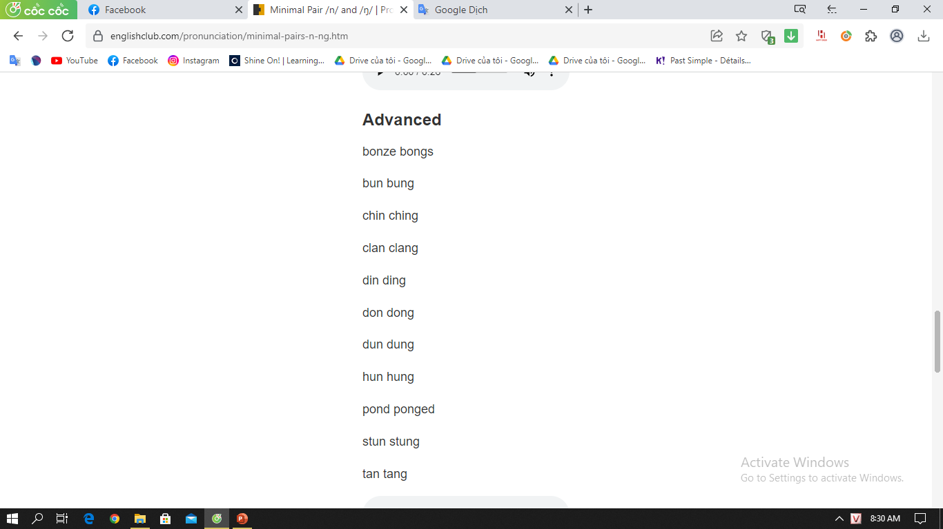
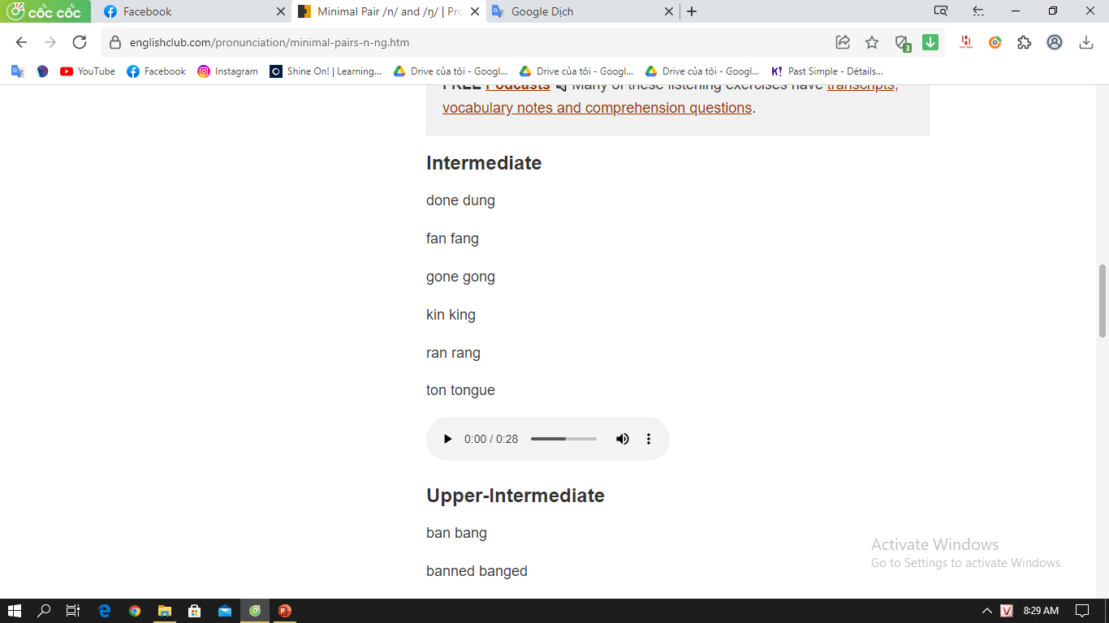
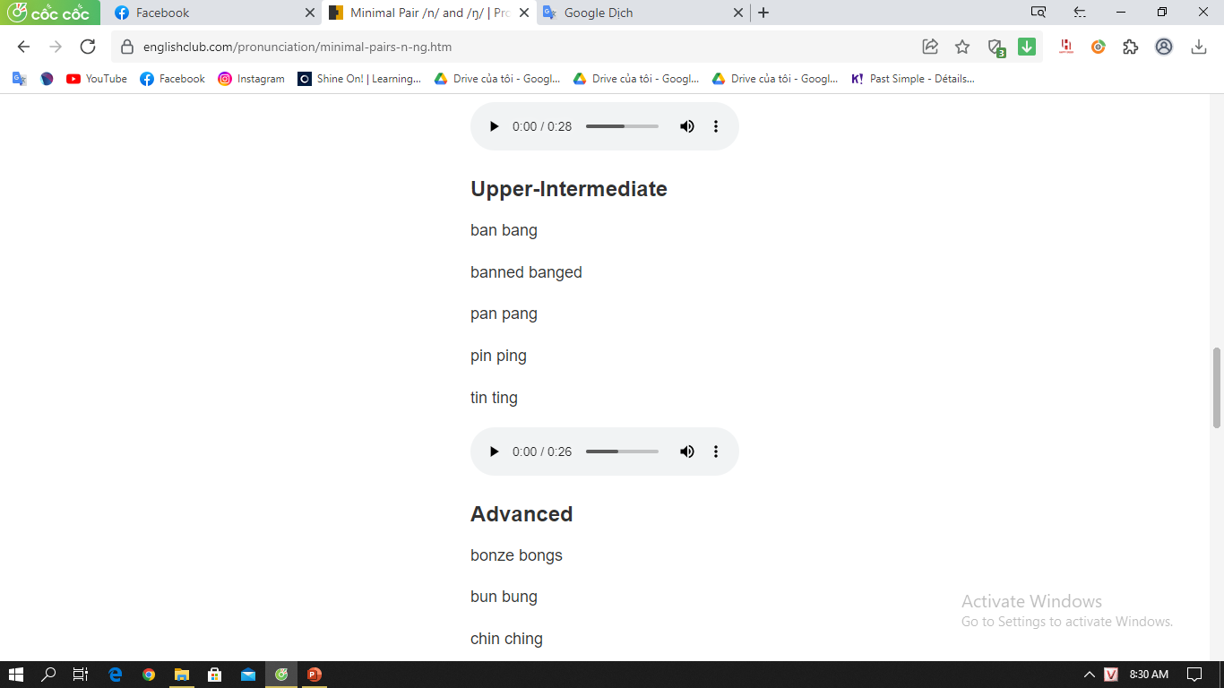

Slide 33
Thanks for your attention!

